Slide 1




Welcome to Tumblebugs - a modified gymnastics and basic movement program for 3½ to 5 year olds. Tumblebugs aims to improve physical literacy by teaching fundamental movement skills that support healthy growth and development. The
program strengthens the range of foundational motor skills that children need to enhance daily living, and participation in play and sports as they age.
The activity plans have been designed specifically for young children – they are fun, safe and developmentally appropriate. They follow a consistent, progressive structure that includes active and quiet segments with both directed and exploratory learning.
The program is intended for educators and practitioners from early childhood settings and programs such as child care centres, pre-primary programs, family resource centres, municipal recreation programs and sport or recreation clubs. These activities are for those who have completed training from an endorsed Tumblebugs workshop.

Slide 2
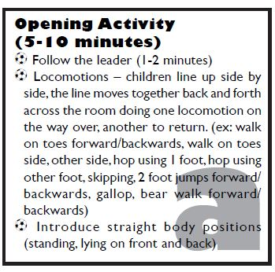
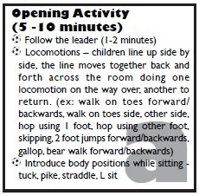
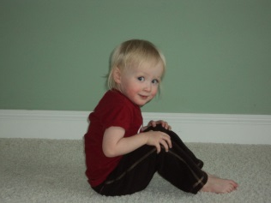
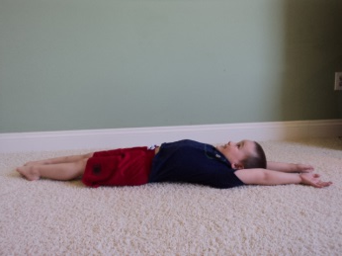
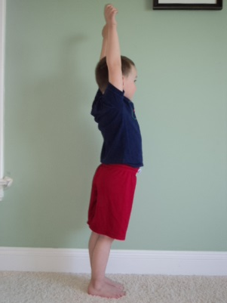
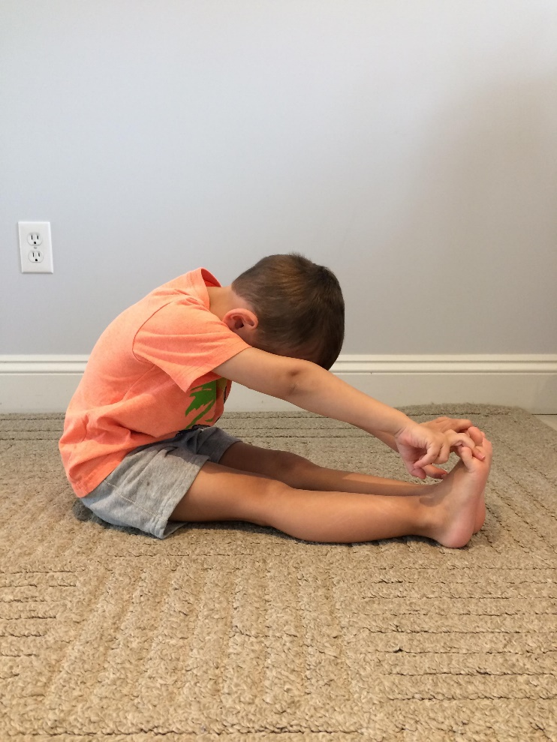
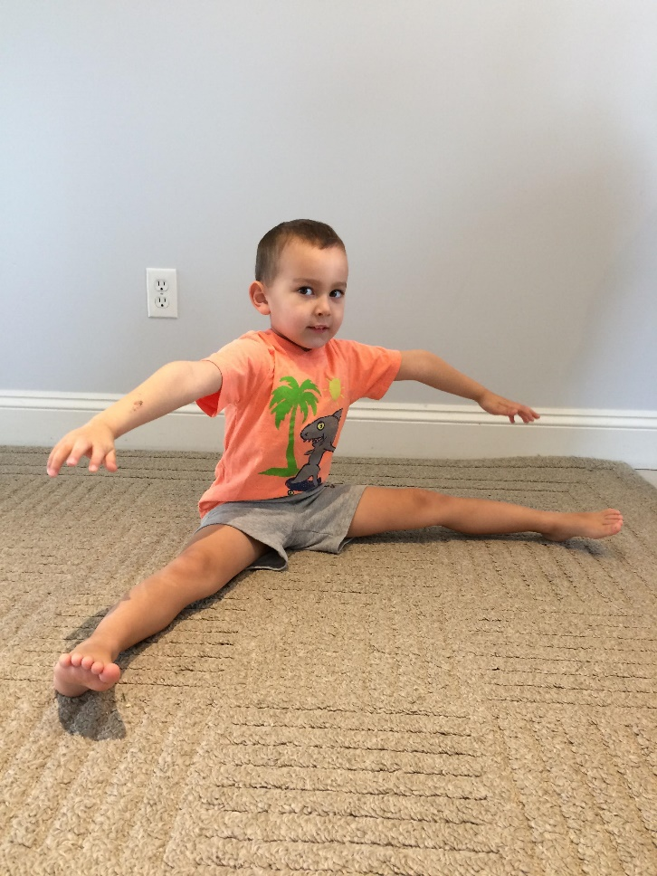
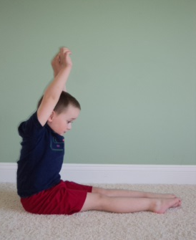
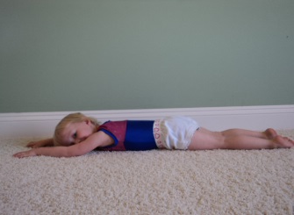
1
2

Slide 3
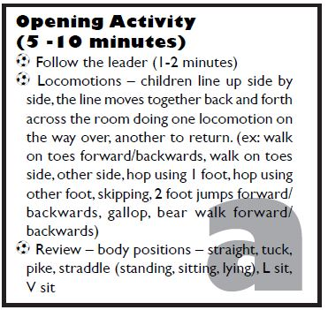
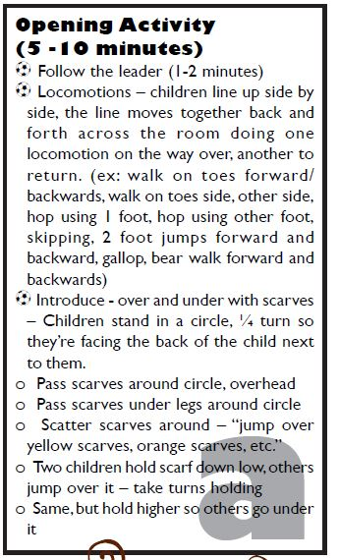


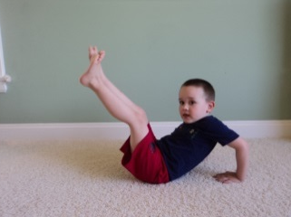
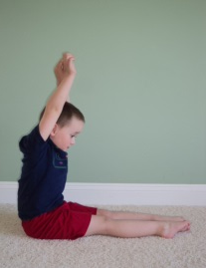
Scarves
3
4

Slide 4
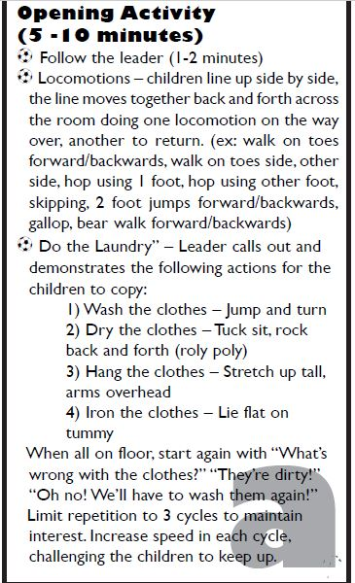
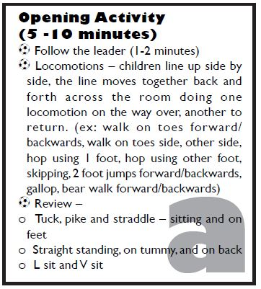
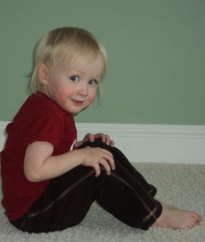


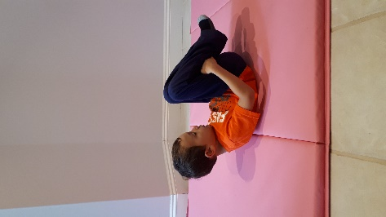
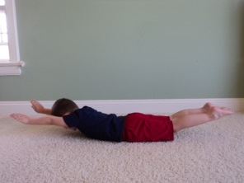


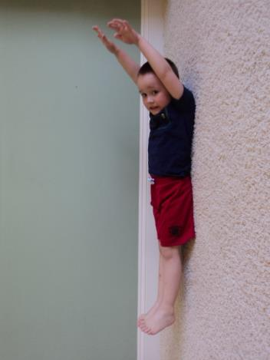
5
6

Slide 5
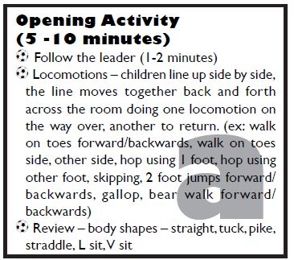
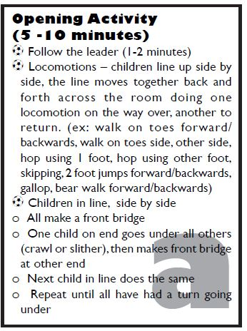
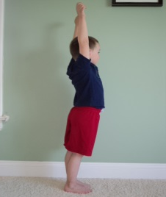
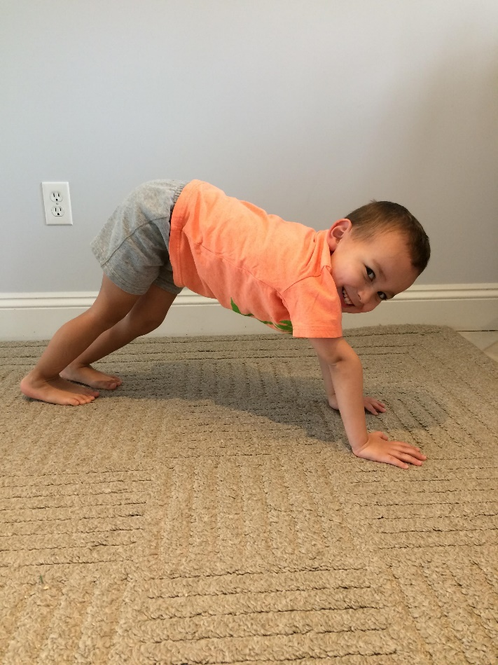
7
8

Slide 6
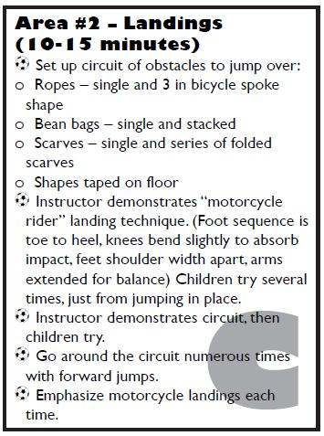
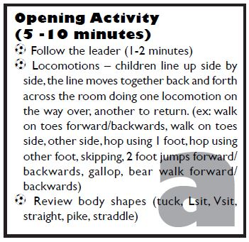
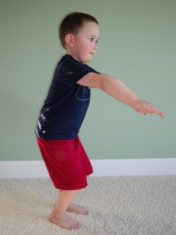
3 Skipping Ropes
Bean Bags
Scarves
Tape
9
1

Slide 7
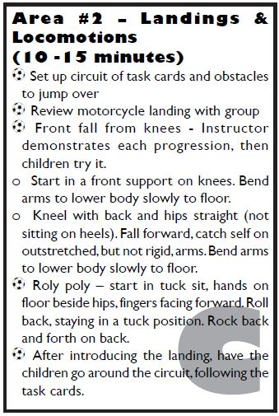
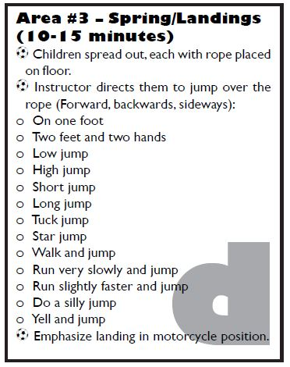
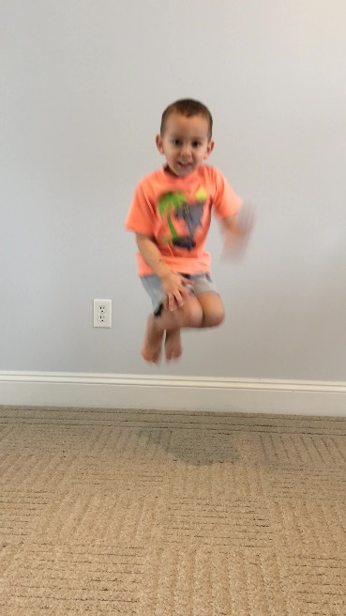
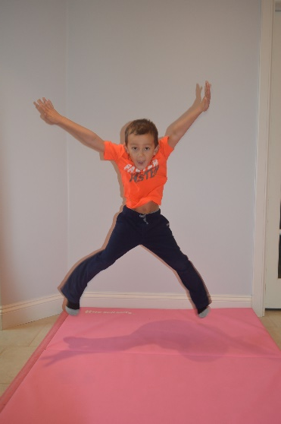

Tape
Ropes, Scarves
Mats, Bean Bags
Task Cards #18, 19, 20, 26, 27
Animals: B, D
Skipping
Ropes
2
3

Slide 8
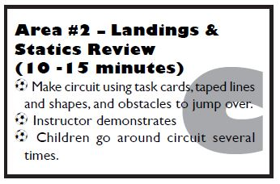
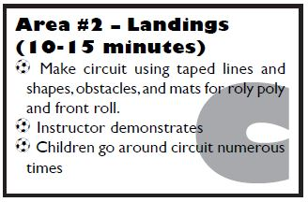
Tape
Task cards # 8, 11-15, 18, 19, 26, 27
Tape
Task cards # 8-11, 15-19, 26, 27
4
5

Slide 9
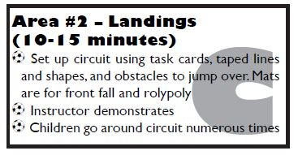
Tape
2 Mats
Task cards # 18, 19, 20, 25-28
Tape
2 Mats
Task cards # 18, 19, 20, 26, 27
Animals: C, D, G, K
6
7

Slide 10
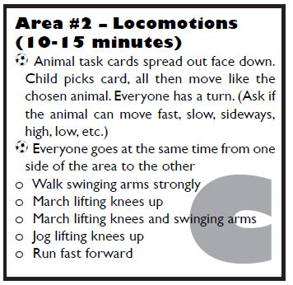
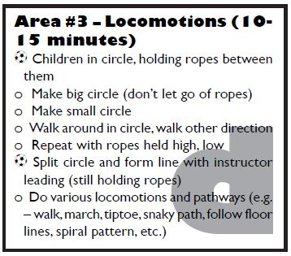
Skipping Ropes
All Animal Cards
1
2

Slide 11
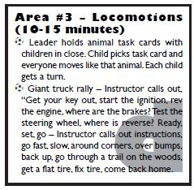
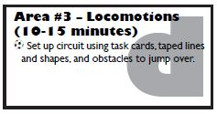
Tape
Bean Bags
Skipping Ropes
Animals: B, C, D, F, I, J, K, L
Animals: A, B, E, F, H, I, J, L
3
4

Slide 12
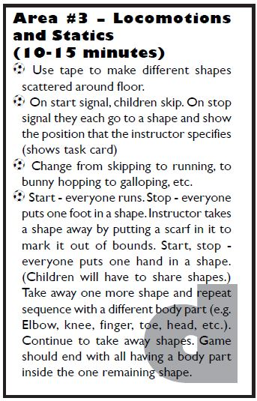
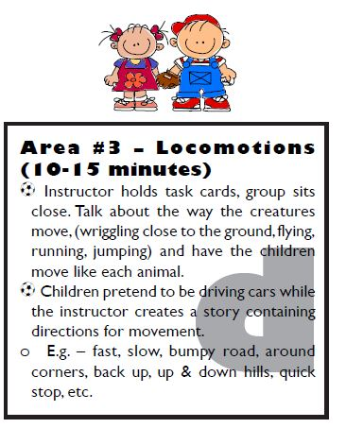
Animals: C, E, J, K, L
Tape
Scarves
Task Cards #1, 2, 3, 12, 13, 17
5
6

Slide 13
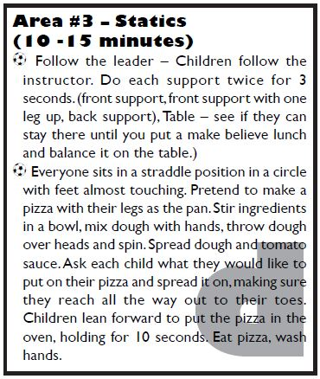
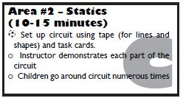
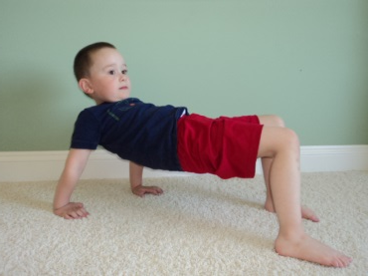
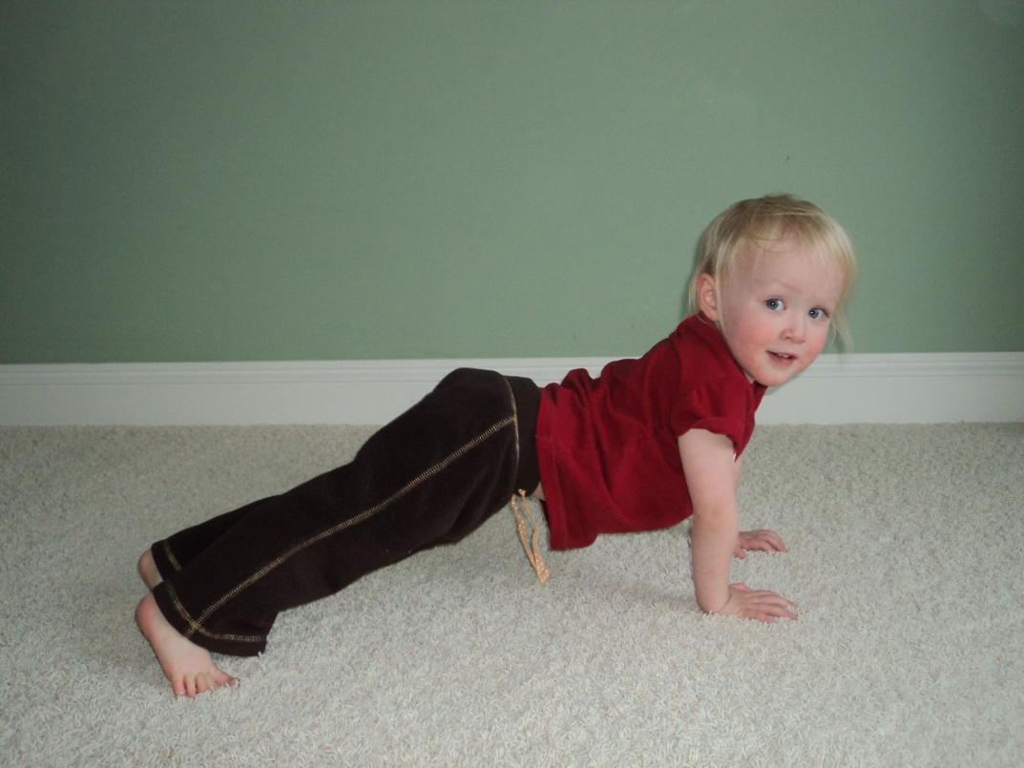
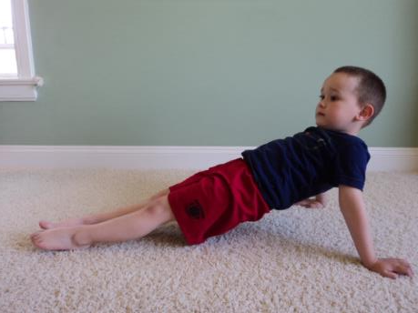
Tape
Task Cards #1-15
1
2

Slide 14
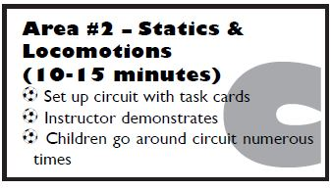
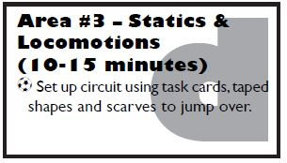
Tape
Task Cards #9-14, 16, 17
Animals: A, B, C, H, F, I, J
Tape
Scarves
Task Cards #9-16
Animals: A, C, D, E, G, I, L
3
4

Slide 15
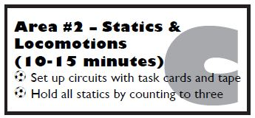
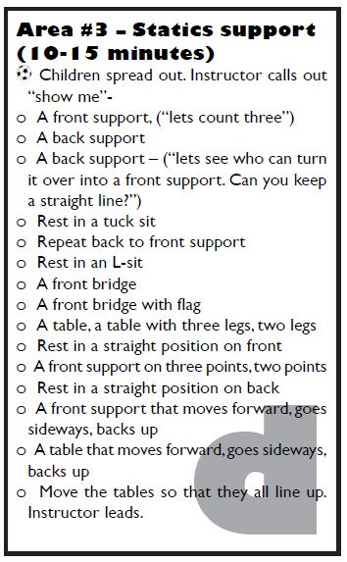
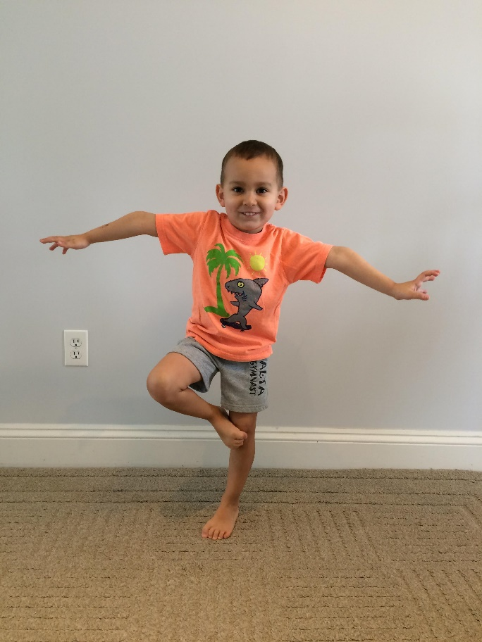

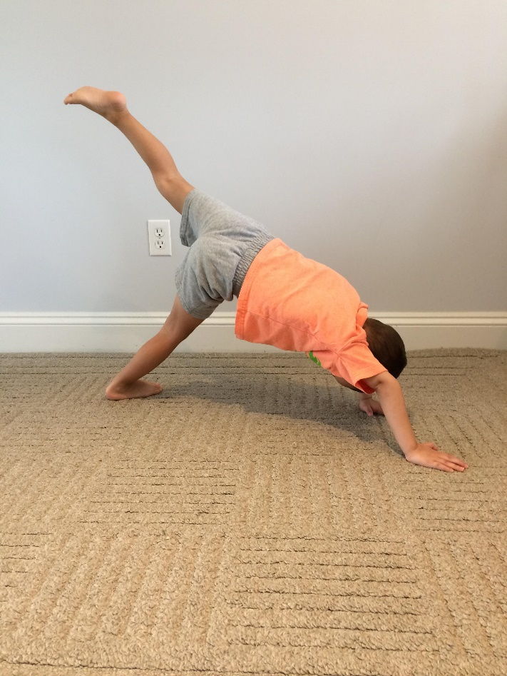

Task Cards #8, 10, 11, 14-16
Animals: A, B, C, E, K
5
6

Slide 16

Tape
Task Cards #4, 6, 8, 9, 11-17
Skipping Ropes
7
1

Slide 17





Tape
Scarves
Bean Bags
Task Cards #26, 27
Animals: A, B, C, D, E, H, I, J, K
Tape
Scarves
Bean Bags
Task Cards #26, 27
Animals: C, D, K
2
3

Slide 18


Tape
Bean Bags
Scarves
Task Cards #26, 27
Animals: A, B, C, D, E, H, I, J, K
Skipping Ropes
Animals: C, D, H, K
5
4

Slide 19

Tape
3 Skipping Ropes
Bean Bags
Scarves
Task Cards #25, 26, 27
Animals: C, D, H, K
Mats
Task Cards #21, 25, 27
6
1

Slide 20


Mats
Task Cards #20, 21, 22, 27
Mats
1 Bean Bag
Task Cards #20, 21, 22, 23, 25
2
3

Slide 21


Mats
Task Cards #20-25
Mats
1 Scarf
Task Cards #20-24
4
5

Slide 22


Mats
1 Scarf
Task Cards #20-27
Mats in a row
6
7

Slide 23


Mats
Bean Bag
Task Cards #20-25
Mats
Scarves
8
9

Slide 24

Mats
Task Cards #20-25
Mats
Task Cards #21, 25, 27
10
11

Slide 25


1
Bubbles
Bean Bags
Scarves
Small Balls
1
2

Slide 26


Beach Balls
1 Beach Ball
3
4

Slide 27


Bubbles
Small Balls
Beach Balls
Beach Balls
5
6

Slide 28


Beach Balls
Bean Bags
7
8

Slide 29


Beach Balls
Tape
Small Balls
Bean Bags
9
10

Slide 30


Skipping Ropes
Ribbons
1
2

Slide 31


Skipping Ropes
Skipping Ropes, Ribbons
Small Balls, Bean Bags
3
4

Slide 32


Skipping Ropes
Ribbons
5
6

Slide 33


Skipping Ropes
Chair or object to tie rope to
7
8
Ribbons

Slide 34


Ribbons
Scarf or item for zapper to hold
9
1

Slide 35




Bubbles
Tape
2
3

Slide 36




Number Bag
4
5

Slide 37



Bean Bags, Scarves
Skipping Ropes, Mats
6
7

Slide 38


Several Animal Task Cards
8
9

Slide 39


Number Bag
10
11

